Slide 1
Introduction :
Since 1980s
reliable, clean, cumbersome
precisely and quickly
Puma 260 , Scara, Speedy and Puma 560

Slide 2
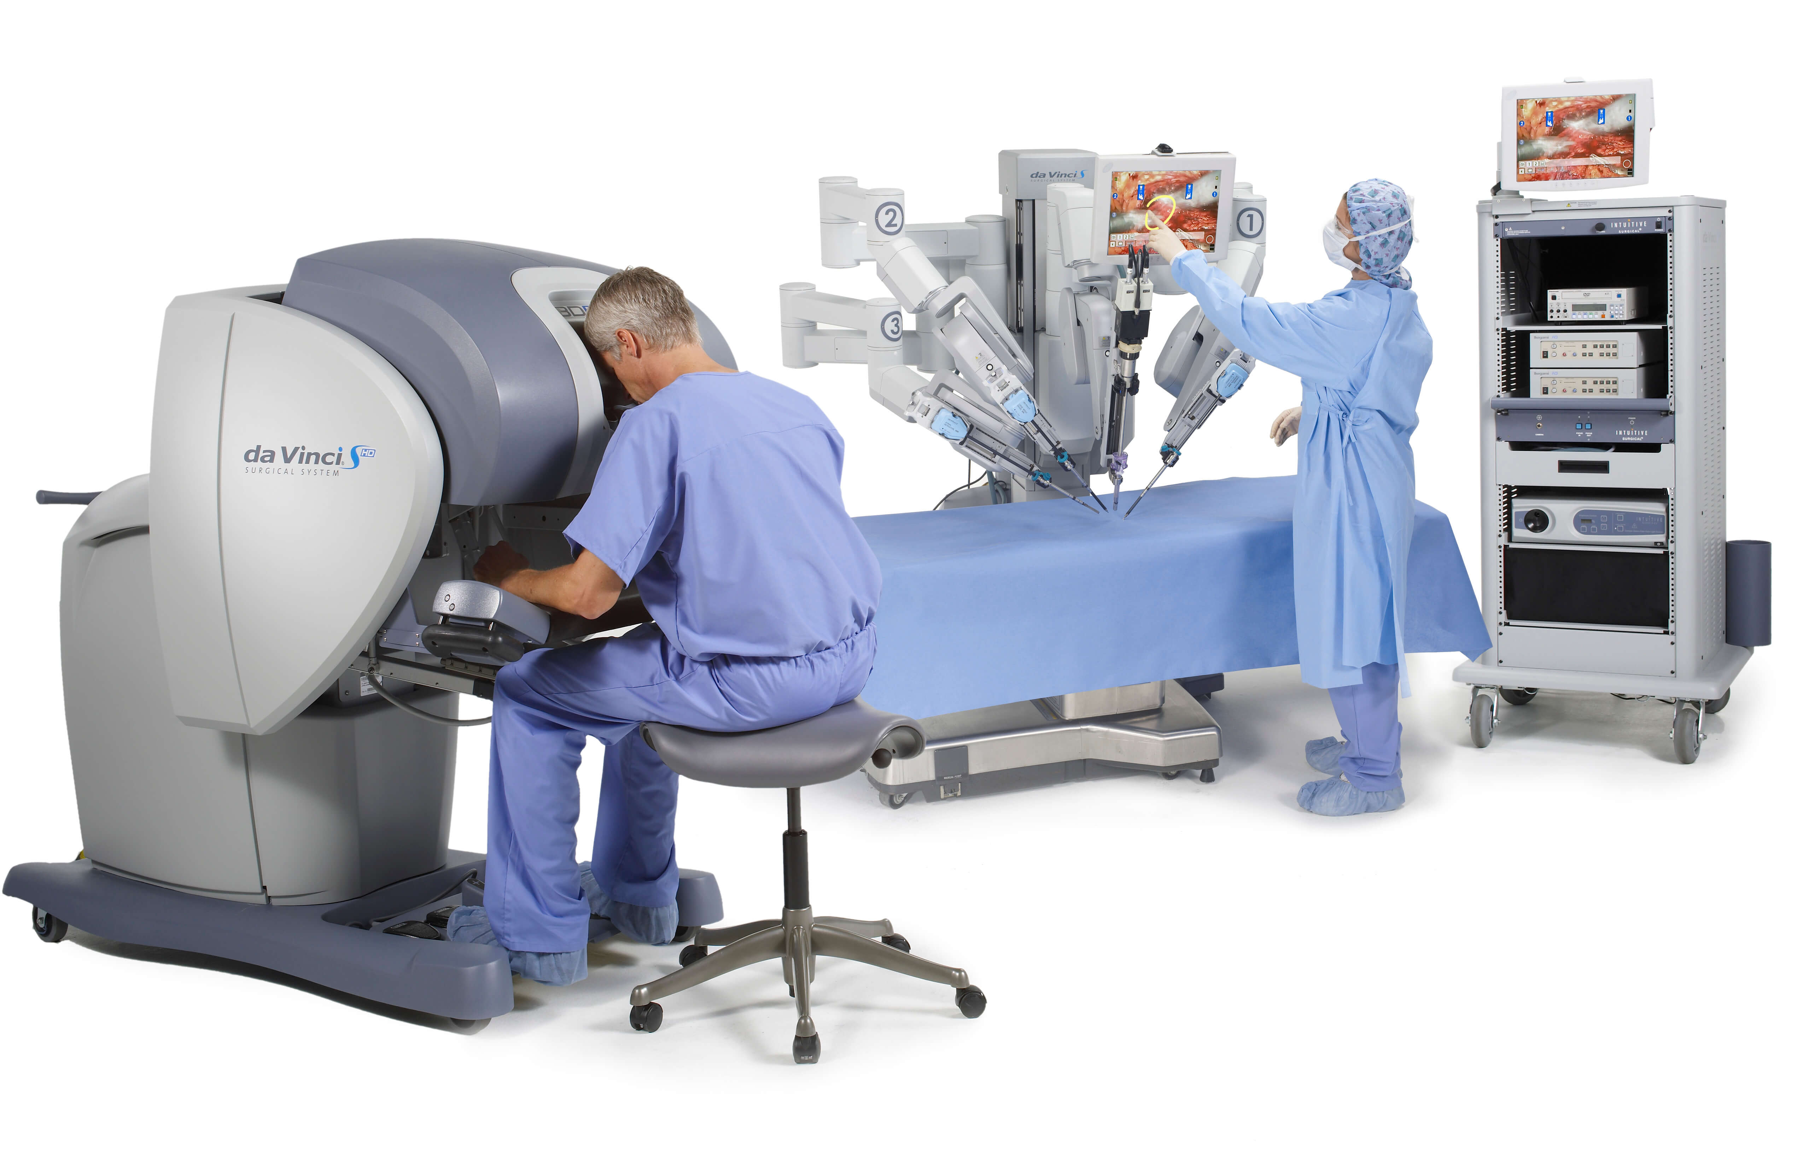
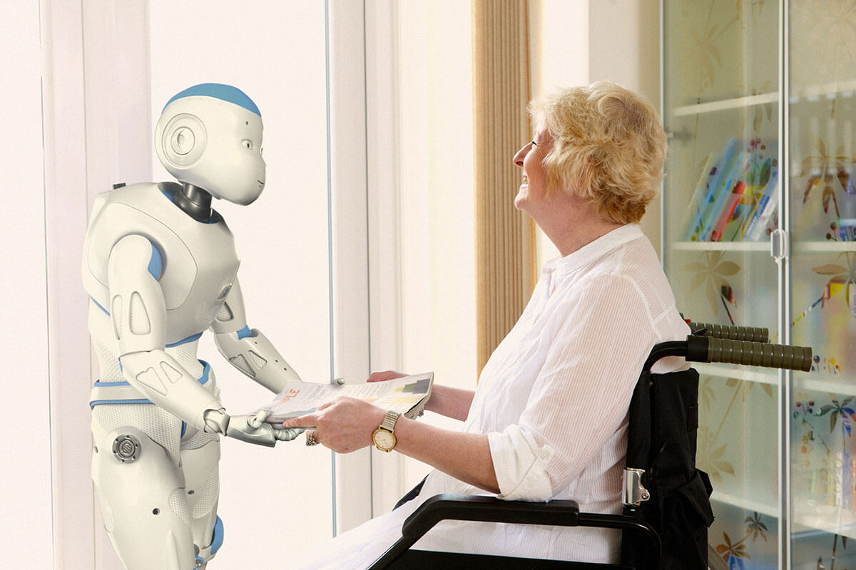
Different fields :
Surgical precision :
better precision
smaller accurate incisions
Robotic assistance :
control with remote control
interact and check
reduce home visits

Slide 3
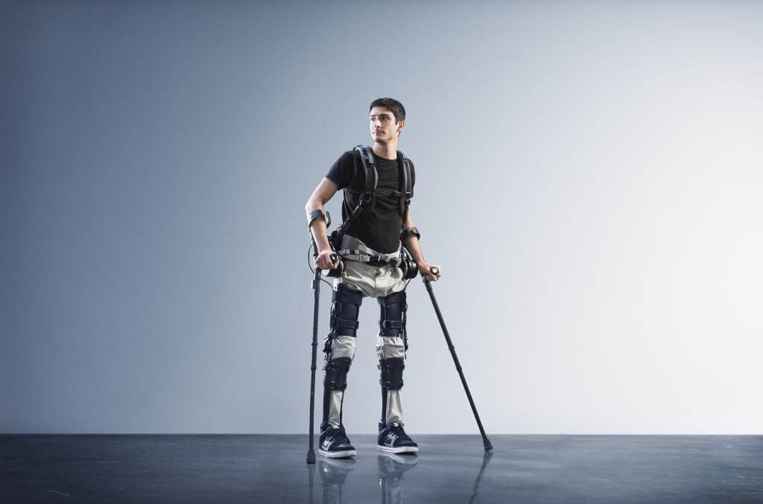
Telemedical Network :
don’t access medical services
use tablet to communicate
better treatments
The powers of Exoskeletons :
help paralyzed people
nurses lift elderly person

Slide 4
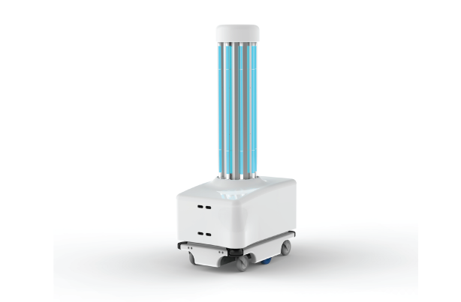
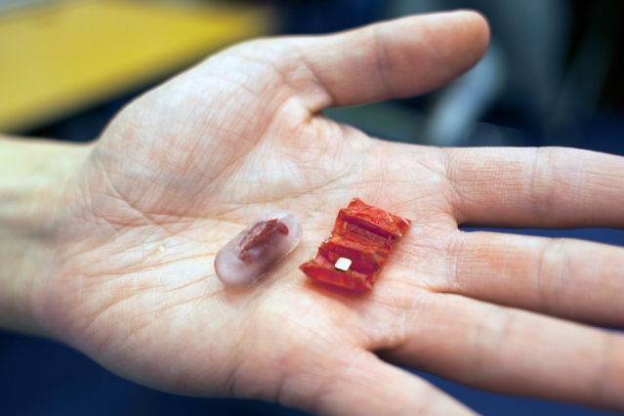
Disinfectant Robots in Healthcare :
infection during operation
use the high intensity ultraviolet light
reduce workload
Robots come in all shapes and sizes :
capsule
swallow
dissolves in the patient's stomach

Slide 5
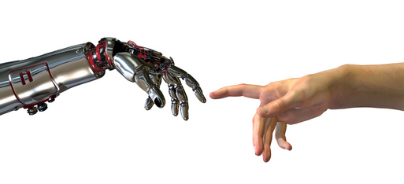
Bionic prosthesis
Notes:
Link : http://www.newzitiv.com/wp-content/uploads/2011/11/1122-un-bras-robot-commande-newzitiv.jpg

Slide 6
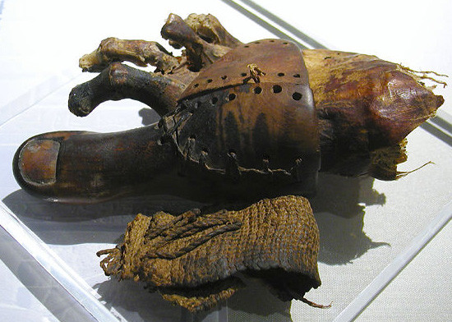
History
Prosthetics have not been invented recently, indeed the oldest is an Egyptian toe prosthesis.
Problem :
But these prostheses perform only limited functions.
Notes:
Link : http://mfs2.cdnsw.com/fs/Protheses/5r1bt-Prosthetic_toe.jpg

Slide 7
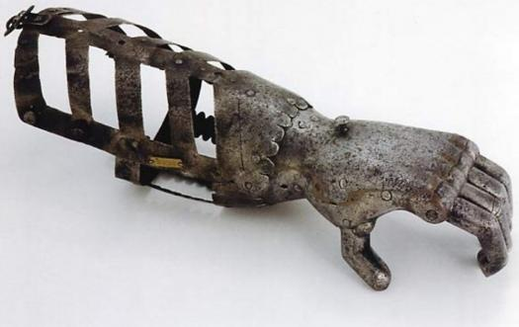
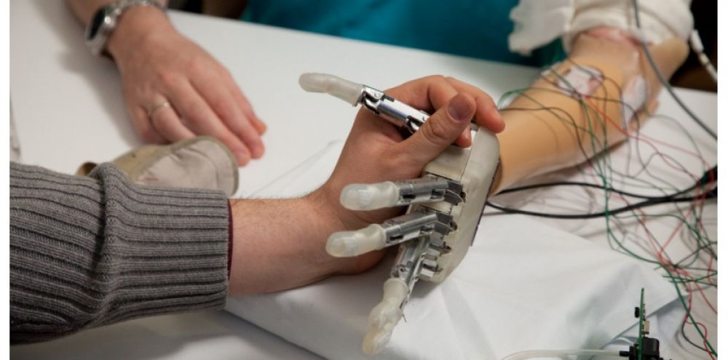
Development
Notes:
Photo 1 : http://groupetpe2013.e-monsite.com/medias/images/moyen-age.jpg
Photo 2 : https://www.sciencesetavenir.fr/assets/img/2014/02/06/cover-r4x3w1000-57df698e9f818-une-prothese-de-main-qui-rend-le-sens-du-toucher.jpg

Slide 8
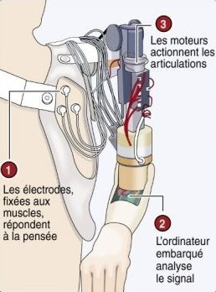
Principle of bionic prosthesis :
The bionic prosthesis is connected to the muscles and the nerves in the amputee member.
The contraction of muscle send electronic signals to the motors of the prosthesis.
Other prostheses are controlled by mind, electrodes are placed on the muscles, they are activated and create the motion.

Slide 9
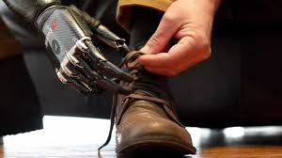
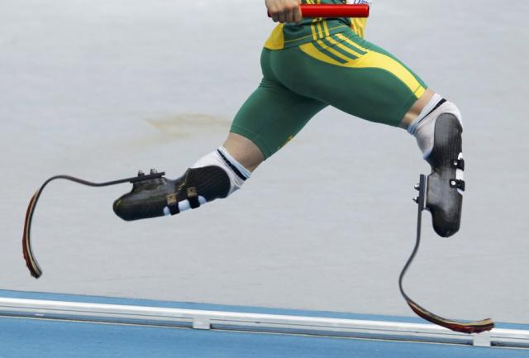
Usage
Daily movements
Sport
Notes:
Photo 1 : https://prothese2017.files.wordpress.com/2017/02/lacets.jpg?w=300&h=168
Photo 2 : http://handisport-tpe.e-monsite.com/medias/images/363879-protheses-sud-africain-oscar-pistorius-1.jpg?fx=r_640_640

Slide 10
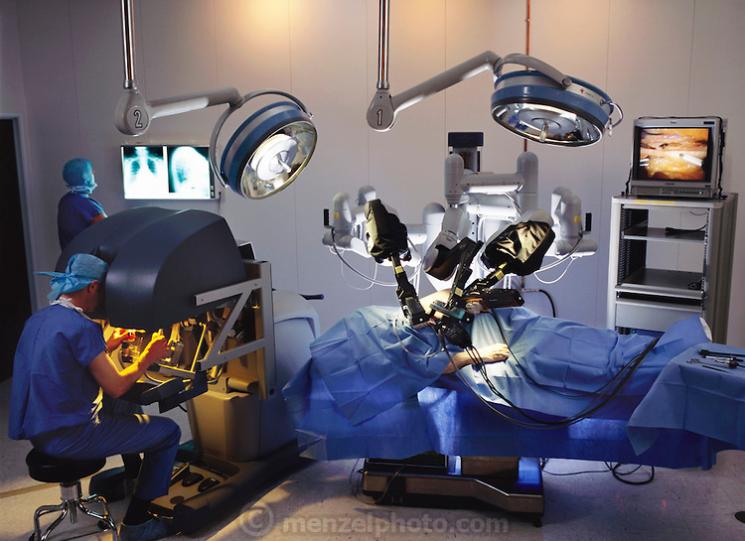
The Prostatectomy by laparoscopy and Da Vinci robot

Slide 11
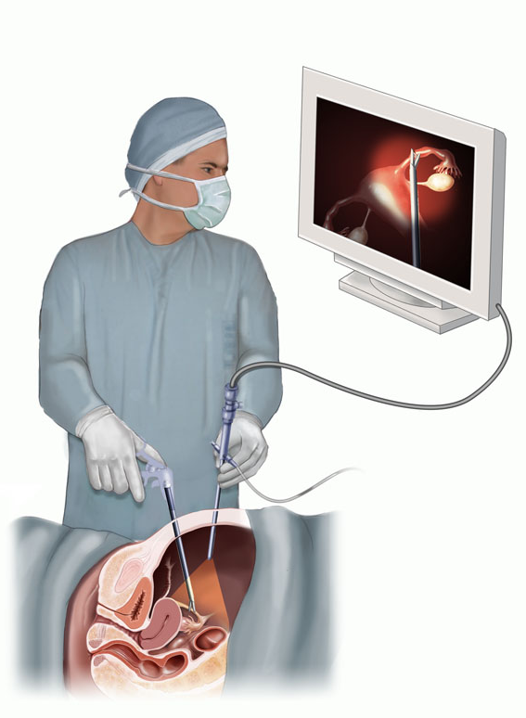
Definitions
Prostatectomy :
Prostatectomy involves surgical removal of the prostate. This procedure is indicated for the treatment of localized or locally advanced prostate cancer.
Laparoscopy : 2D vision

Slide 12
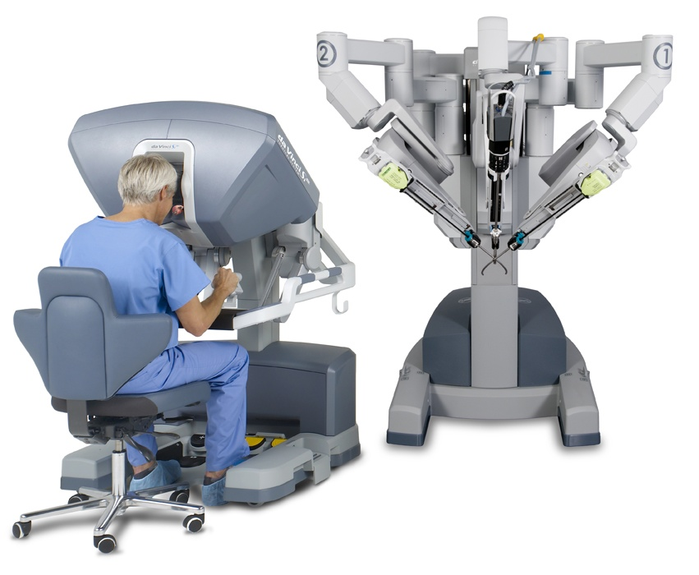
Description of the robot
3D Vision
Arm with the camera
Surgeon
Surgery arms
Control commands

Slide 13
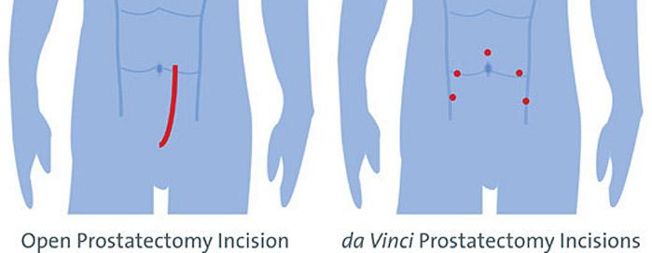
Advantages
Accuracy
The articulation of the instruments, (7 degrees of freedom, against 2 without this robot)
Elimination of the eventual tremor of the surgeon's hand
3D vision
Fewer scars after operation

Slide 14

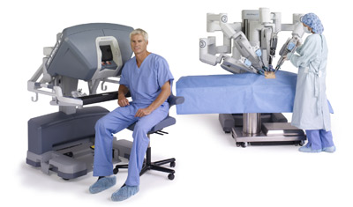

Disadvantage
Robot
Maintenance
Training
+
+
2 000 000€
150 000€
It’s expensive
=
an increase of 2000 € per operation for the hospital center

Slide 15
Conclusion :
Ethical issue :
If the machine arm has a problem and hits someone, who have wrong ? The arm or the person ?

Slide 16
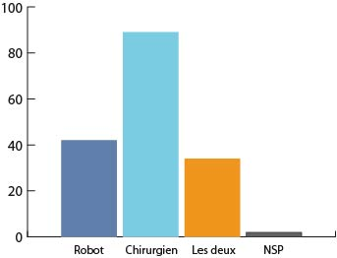
Social issue :
People don’t have complete confidence towards robots :
The evolution of robots will increase the number of unemployment ?

Slide 17
Technological limitations :
If there is a problem during surgery, robots don’t have the same reactions that humans. So they can be dangerous.
For long surgery, robots have not a sufficient battery life yet.

